Slide 1
Colormanagement

Slide 2
Theory of Colormanagement
Based on ICC-Technology
      (ICC = International Color Consortium)
      worldwide Standard
      future-proof

Slide 3
What is color?
Color is a visual information submitted by your eyes, interpreted by your brain

Slide 4
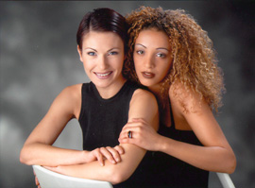
Effect of light
Different luminous sources → different effects
Standard: D50 → Daylight 5000°Kelvin

Slide 5
Impression influenced by environment

Slide 6

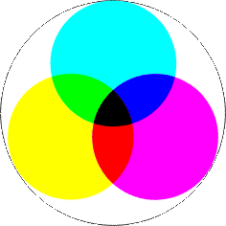
Systems of color mixture
RGB → additive mixture of color
    scanner
    camera
    display
CMY → subtractive mixture of color
    printer
    platesetter
    printing pres

Slide 7
What defines a color (What is HSL)?
Lightness/Luminance
Saturation
Hue

Slide 8
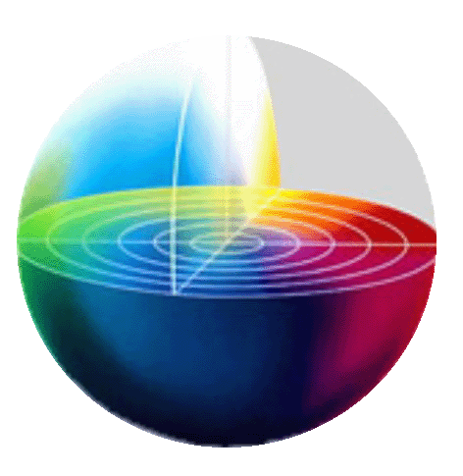
Lab-color-space
L → Lightness/Luminance
  0 to 100
a → red-green-axis
  -127 to 127
b → yellow-blue-axis
  -127 to 127
            → device-independent
L100
b
- a
a
- b
L0

Slide 9
Why Colormanagement?
Treatment, handling and transmission of colordata
    stable
    predictable
    Inside color-space of different devices (Gamut)

Slide 10
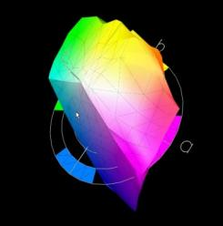
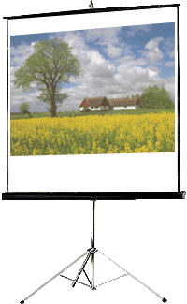
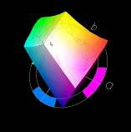
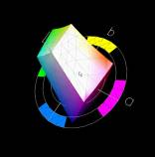
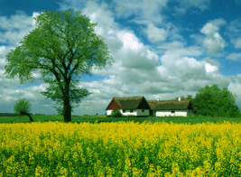
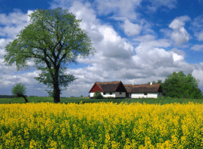
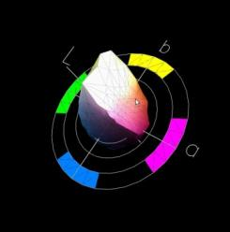
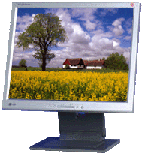
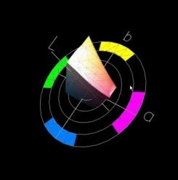
Displaying without Colormanagement
Scanner RGB
Monitor RGB
Projektor RGB
Inkjet
Offset

Slide 11
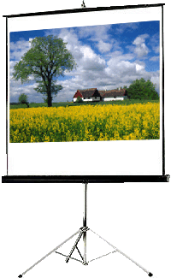
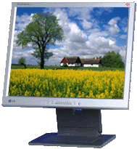
Goal of Colormanagement
Scanner RGB
Monitor RGB
Projektor RGB
Inkjet
Offset

Slide 12
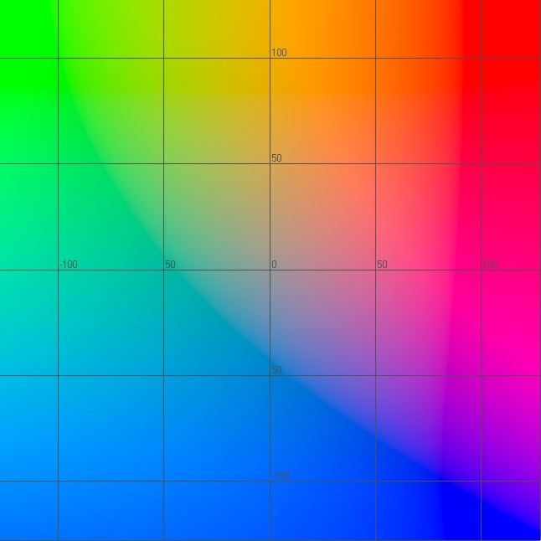
Gamutmapping
8
7
6
5
4
3
2
1
8
7
6
5
4
3
2
1
5
4
3
2
1
Replacement of not viewable colors from source-color-space in destination-color-space → as unobstructive as possible
ECI-RGB
ISO-Coated-CMYK

Slide 13
What is an ICC-Profile?
Translation-Matrix for colors
RGB | Lab | CMYK
128 – 128 – 128 | 50 – 0 – 0 | 47 – 36 – 35 – 10
202 – 121 – 91 | 60 – 45 – 40 | 5 – 53 – 60 – 0
241 – 0 – 31 | 60 – 92 – 83 | 0 – 91 – 91 - 0

Slide 14
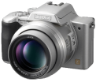
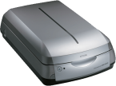
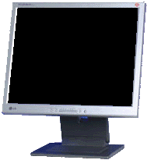
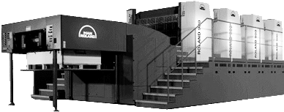
Utilization of ICC-Profiles
Original
Lab 50-0-0
RGB 96-108-101
Lab 50-0-0
Color Management Workflow
RGB 91-99-103
Lab 50-0-0
RGB 110-102-99
Lab 50-0-0
CMYK 49-41-38-24
Lab 50-0-0

Slide 15
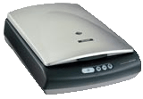
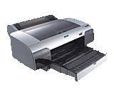
Functionality
Target-profile: Display
L = 50
A = 0
B = 0
R = 118
G = 115
B = 123
Source-profile: Scanner
R = 130
G = 110
B = 115
L = 50
A = 0
B = 0
Target-profile: printer
C = 49
M = 41
Y = 38
K = 24
L = 50
A = 0
B = 0

Slide 16
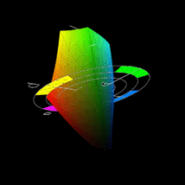
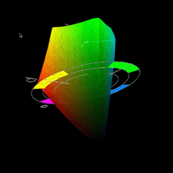
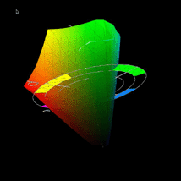
Standardprofiles
Standardprofiles are defined standard-color-spaces in Lab
sRGB
    Average color-space of displays
Adobe98-RGB
    Internat. Standard-color-space
ECI-RGB
    Europ. Standard-color-space
Source-color-spaces for selfmade pictures or target-color-space for special functionalities (e.g. data-transmission)

Slide 17
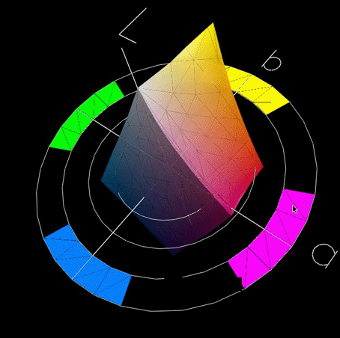
ISO(un)coated standardprofile FOGRA
Profile for printing by Proces Standard Offset
ISO-Coated-CMYK
sRGB
Adobe-RGB
ECI-RGB
Advantage of ECI-RGB:
Contains these and most other standardprofiles

Slide 18

Transformation of color-spaces Methode 1
source-color-space
target-color-space
Greater color-space will be compressed into smaller one
colormetric all colors will be changed
Appropriate to conserve the visual impression of the original

Slide 19
Transformation of color-spaces Methode 2
Keep colors 1:1 with adjustment to smaller color-space (smallest distace of colors)
Identical colors will be preserved
Visual impression of colors not in destination-color-space may change
source-color-space
target-color-space

Slide 20
Rendering Intents
Perception
    Colors adjusted to visual impression(Compression)
    Generating data for production (pictures)
Relative colormetric
    Smallest distance of colors
    Generating data for production (pictures/Logos)
    Proof to paper for print-run
Absolutely colormetric
    Smallest distance of colors with simulation of paper in destination-color-space (Whitepoint)
    Proof to white proof-paper
Saturation
    Colors adjusted to max. saturation & hue
    Business art work & chart

Slide 21


Rendering Intent
How do i decide in real?
    Use Rendering Intent with fewest changes of colors in picture
    (Photoshop: use preview)
sRGB-RGB
ISO-Coated-CMYK
Adobe-RGB
Zeitungs-CMYK
Scanner-RGB
ECI-RGB
Adobe-RGB
Fotolabor

Slide 22
Rules
Rendering Intent mostly dependent on motive
  but
      Never convert absolutely colormetric (Whitepoint will change to white of paper → color on none-printing areas)
      Never proof perceptive (colors will change to original → but goal of a proof is printig color mosty unchanged 1:1 if possible)
      Never convert perzeptive from smaller color-space to bigger ones (unwanted displacements of colors e.g. CMYK to RGB → 1:1 possible otherwise use relative colormetric)

Slide 23
We need
Technical equipment to get color information
Software to generate profiles
ICC-Profiles
    source-profile
    target-profile
Software with integrated Colormanagement (Adobe-Products/Corel/Quark/Scribus/Gimp)
Knowledge about how to use color-profiles

Slide 24
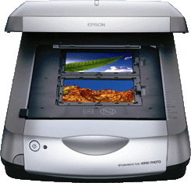
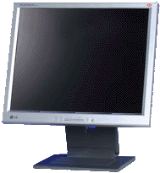

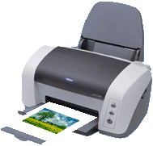
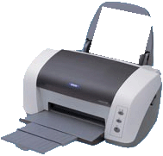
Problem solved
RGB LAB
ICC-Profile scanner
RGB LAB
Lab
ICC-Profile display
CMYK LAB
ICC-Profile print

Slide 25
Advantages of Colormanagement?
reduces workload
cost-efficiency
quality-assurance
less consumption of materials
time-saving
reduces customer complaint-rate

Slide 26
Calibrating & profiling displays
Calibrating means standard adjustments of
    Lightness/Luminance
    Contrast
    Adjusing color-temperature
      D50 production & proofing (PSO)
      D65 (still in use but obsolete)
      → CRTs need ca.1h reaching color-temperature
      → LCDs & LEDs lose luminance after some time
Profiling means generate translation-matrix for LAB to RGB-device-color-space
    send special RGB-Values to display
    measure RGB-output of display
    Generate profile by measured Values of RGB based upon D50
      Translation-matrix from display (Lab to RGB)

Slide 27
Periodically repaeting calibration and profiling display
Depends on type (cheap / high class)
Depends on kind of display (LED / TFT / CRT / Plasma)
Take care of cleaner-factor
rough-and-ready-rule: once per month
    TAKE CARE: dependent on Software the activation of profile will be done by operating-system, Adobe CS or special calibration- and profiling-software

Slide 28
Printing process RGB or CMYK
Printing by driver: RGB
Controlled by RIP: CMYK
Printing on printing press: CMYK

Slide 29
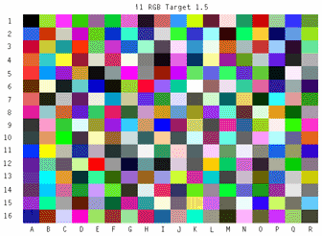
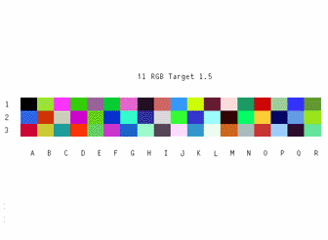
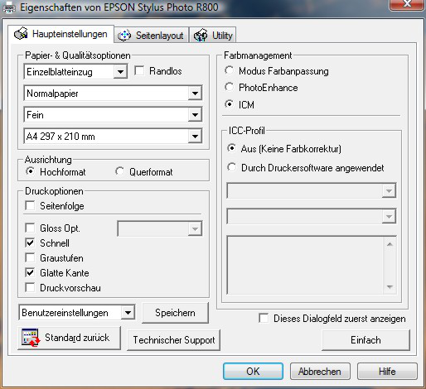
Profiling printer with testchart
Testchart with plenty of color-fields
    ECI 2002 Testchart (1485 colors)
Linearisation (RIP-) Software
Deactivate color-adjustments in driver and RIP
Dot-gain must be known
Testchart (RGB or CMYK) will be sent to printer and after that measured (Lab)
Assign Lab-Values to CMYK- or RGB-Values
Generate device-profil

Slide 30
Standard oder individual printer-profile
Preferably individual profile because
    A printer of same type is not YOUR printer
    Individual profiles allow cosideration of YOUR whole workflow
    Paperprofiles:
        White paper will be read from every test-chart
        Will be used by abs. colormetric Rendering Intent
        New paper → new profile

Slide 31
Profiling scanner
Read testcharts (Lab)
Scan testcharts (RGB)
Generate color-matrix RGB – Lab
    TAKE CARE: even lamps in scanners will perish
    Mostly the profile can be imported directly to scanner-software

Slide 32
Profiling of cameras
Because of unstable process individual profiles are very difficult and almost impossible to generate
Possible when continuous shooting or stable lighting conditions
    Needed when taking photos from products or fashion
    Generating profile for camera equals generating profile for scanner
No color-management inside of closed system camera
But correct translation of values to Lab is possible
    Cameras for private use mosty deliver sRGB
    Cameras for professional use deliver AdobeRGB or
    High-End devices use RAW-Format (no influence from outside)
        After taking picture userdefined profiling in RAW-conve

Slide 33
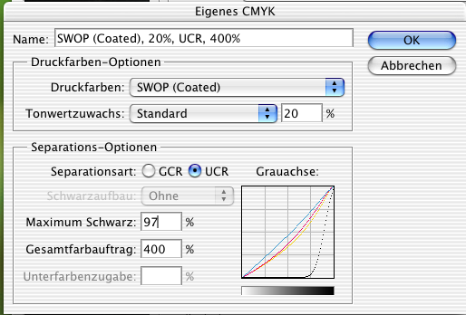
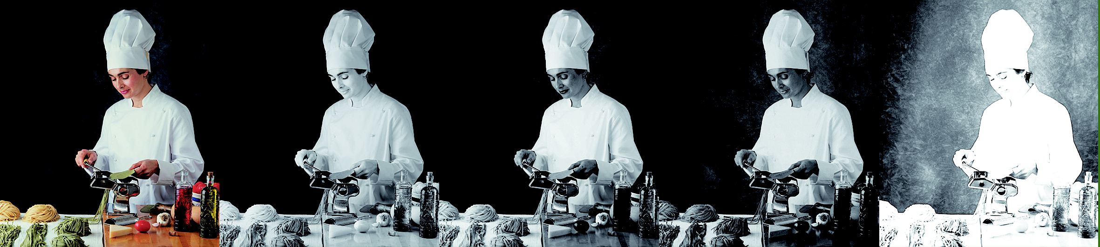
Colorisation with CMY with black as skeleton
All colors and also grey areas will be composed by CMY
Black only as an skeleton with ¾ coverage
Darkest color: 97%K 100%C 100%M 100%
CMYK
C
M
Y
K

Slide 34
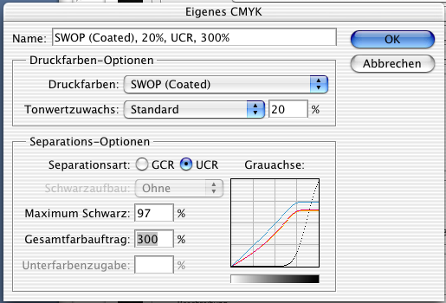
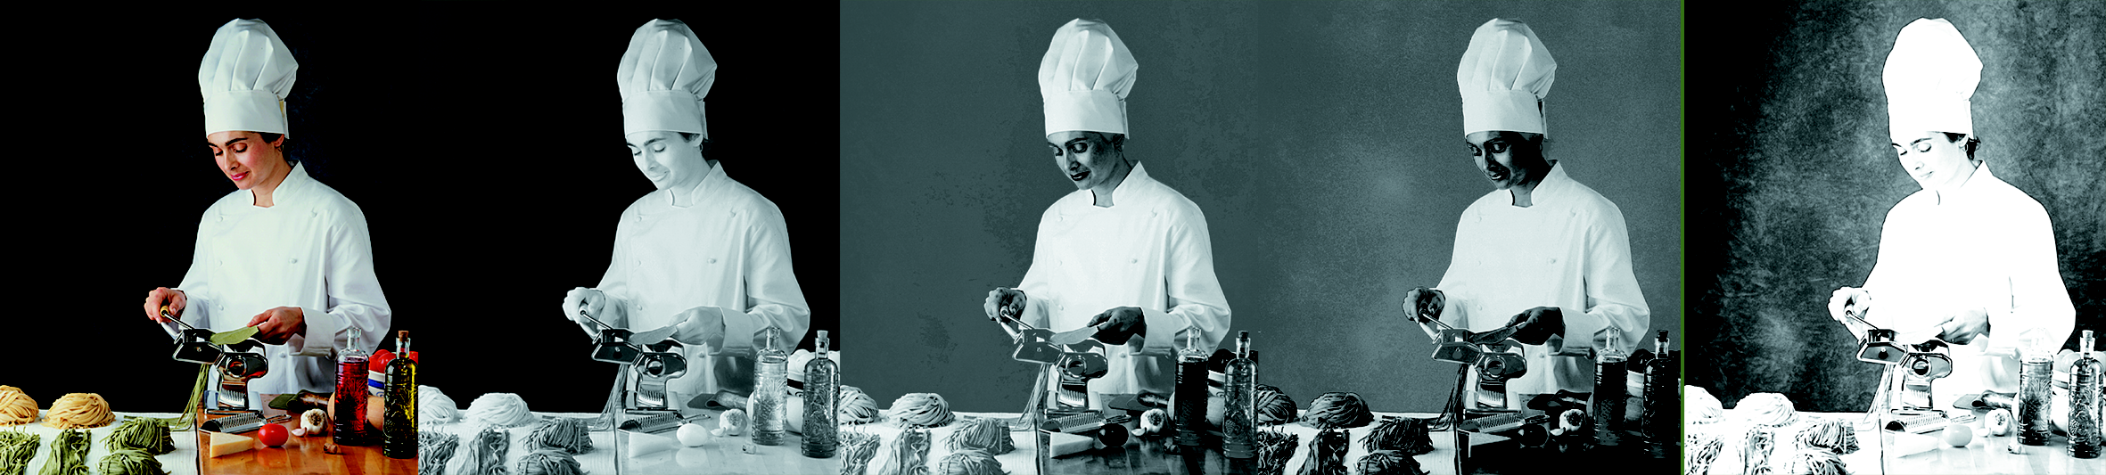
UCR (Under Color Reduction)
For every point composed by CMY the amount of CMY will be reduced and replaced by black
Darkest color: 97%K 60%C 60%M 60%Y
CMYK
C
M
Y
K

Slide 35
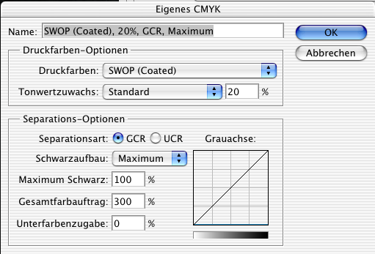
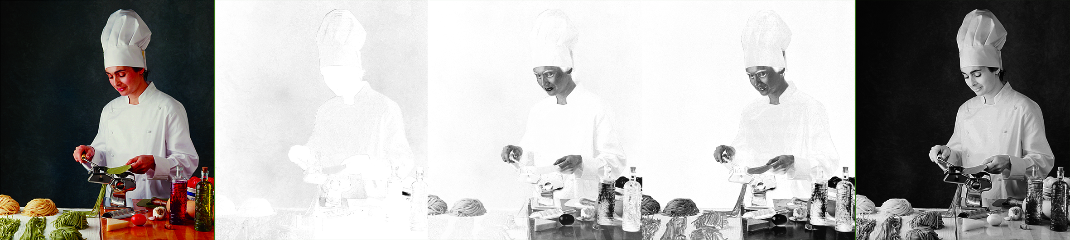
GCR (Gray Component Replacement)
Every composition of CMY will be replaced by black
Enhances stability in printing process
Smallest amount of color needed
Losing brilliance
CMYK
C
M
Y
K

Slide 36
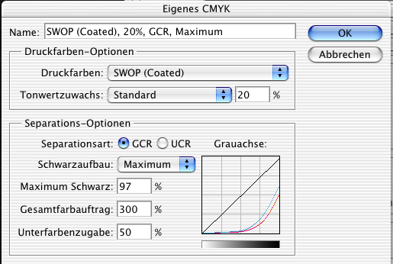
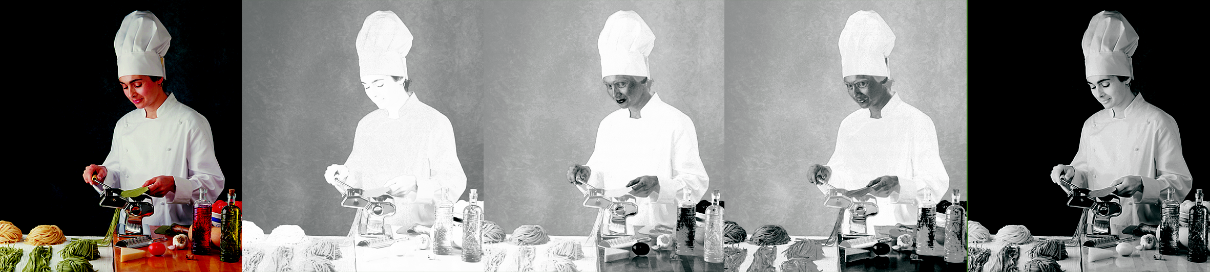
Under Color Addition
Real gray (amount of C=M=Y) replaced by black
Adding CMY at ¾-tones for better contrast
CMYK
C
M
Y
K

